Slide 1

Library Management System
Mentor –
Ms. Meenakshi Maindola
Name – Garvit Jain
Section – CE
University Roll No. - 2017327

Slide 2


Problem Statement:
Design a Library Management System

Slide 3
Introduction
A Library Management System manages and stores books information electronically. The system helps both students and library manager (Admin) to keep a constant track of all the books available in the library.
A Library Management System is a system that is used to maintain the records of the library. It contains options for various tasks like the number of available books, the number of books issued, the number of books to return or renew.

Slide 4
Methodology
Database Connection
To connect the oracle database to the Java application, we need following requirements:
Driver class: The driver class for the oracle database is oracle.jdbc.driver.OracleDriver.
Connection URL: The connection URL for the oracle database is jdbc:oracle:thin:@localhost:1521:xe
Username: The default username for the oracle database is system.
Password: It is the password given by the user at the time of installing the oracle database.

Slide 5
Database Design
The schema designed for the database for this library management system is:
Admins (aid, username, password, name, phone)
Books (bid, bookname, price, genre)
Issued (sid, bid)
Students (sid, username, password, name, phone)
Issued_Details (iid, bid, sid, issuedate, returndate, period, fine)

Slide 6
User Interface
The user interface for the application is designed using NetBeans software.
Swing is a GUI widget toolkit for Java. It is part of Oracle's Java Foundation Classes – an API for providing a graphical user interface for Java programs.
The Major java swing and awt tools used for the development of this application are Jframe, Jlabel, Jbutton, JTextField, JPasswordField, Jtable etc.

Slide 7
RESULT
The users can distinguish themselves as admin or user (student in this case as it is being considered for a library in an educational institution) and can login with their login credentials accordingly
After Logging In the person can perform various tasks according to their rights and the menu providing options for those tasks

Slide 8
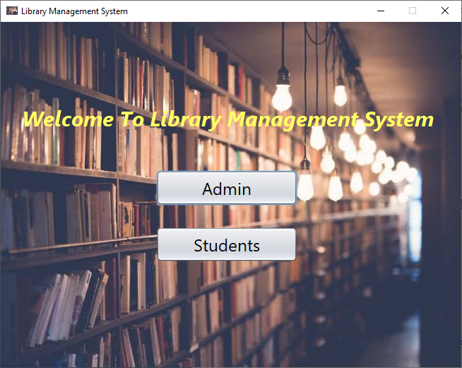

Slide 9
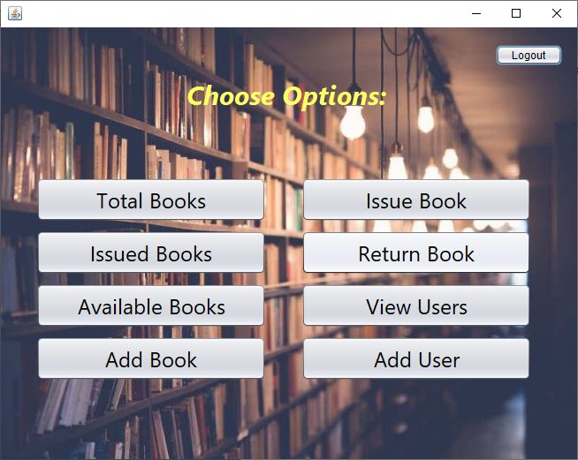

Slide 10
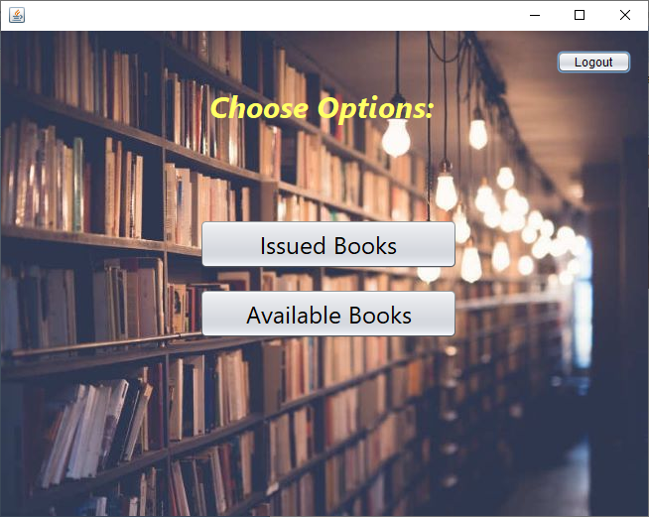

Slide 11
Conclusion and Future Work
The website provides a computerized version of library management system which will benefit the students as well as the staff of the library
There is a future scope of this facility like a feature of group chat where students can discuss various issues of various subjects, making it compatible for distance learning platforms

